Slide 1
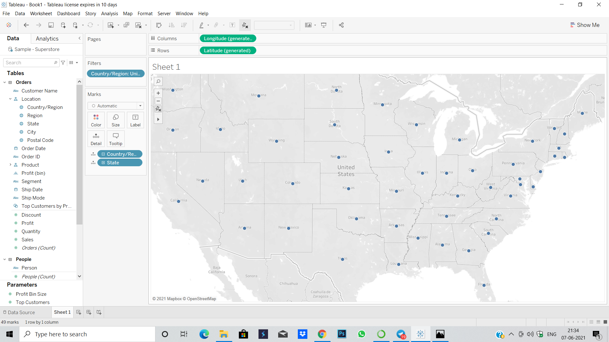
Create a map view to represent all the states of a country

Slide 2
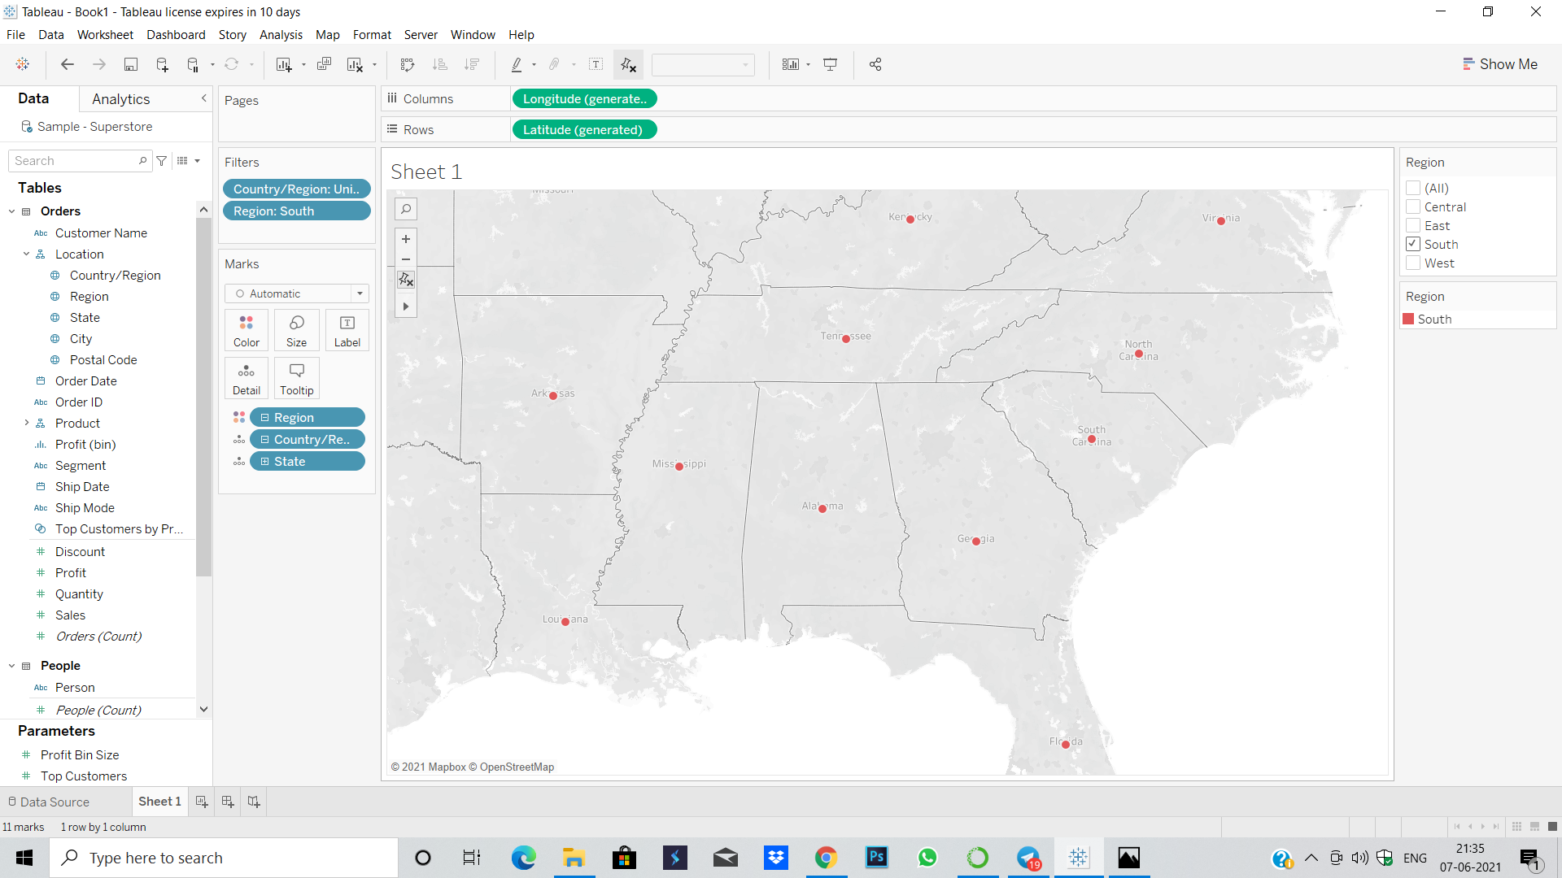
Check your map for south region

Slide 3
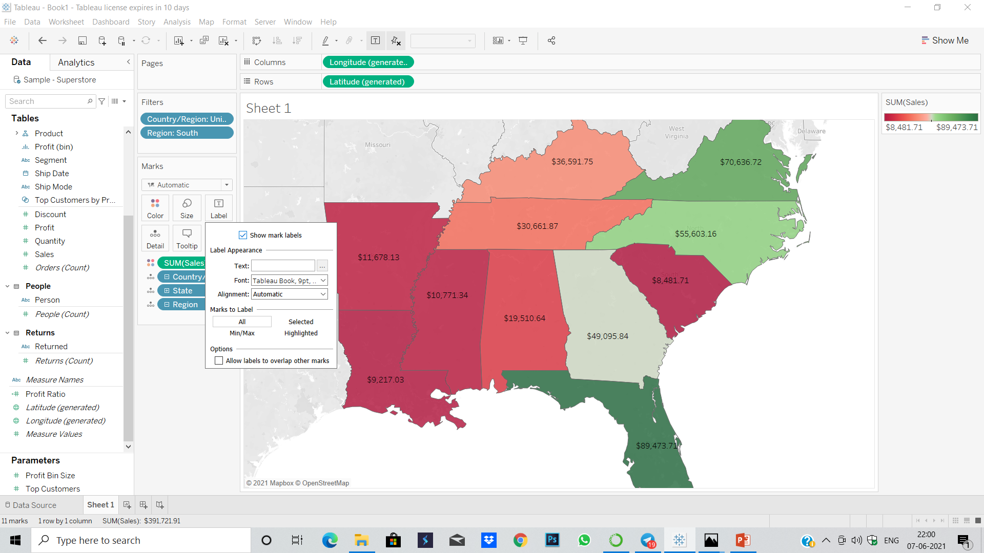
Check the sales for south region

Slide 4
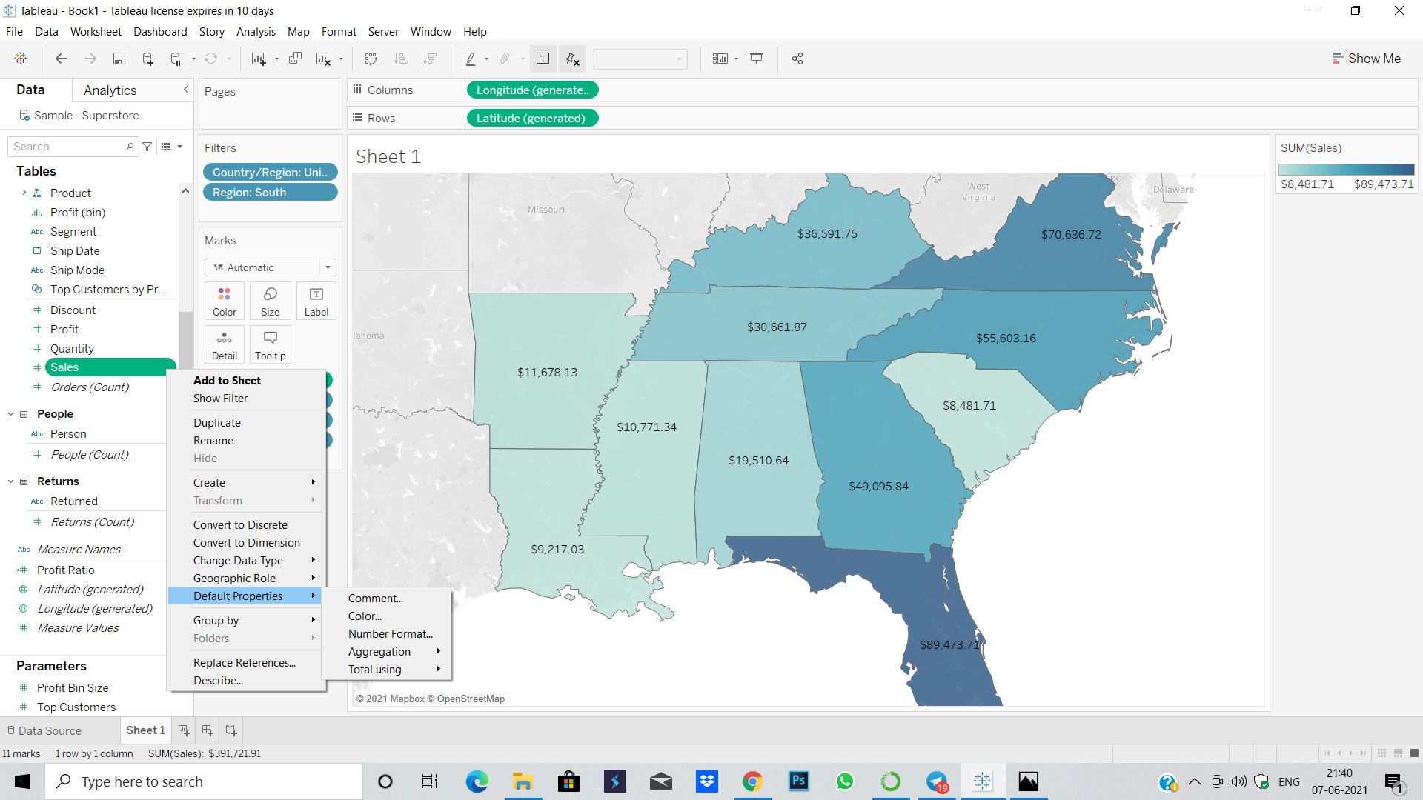
Represent your sales in USD

Slide 5
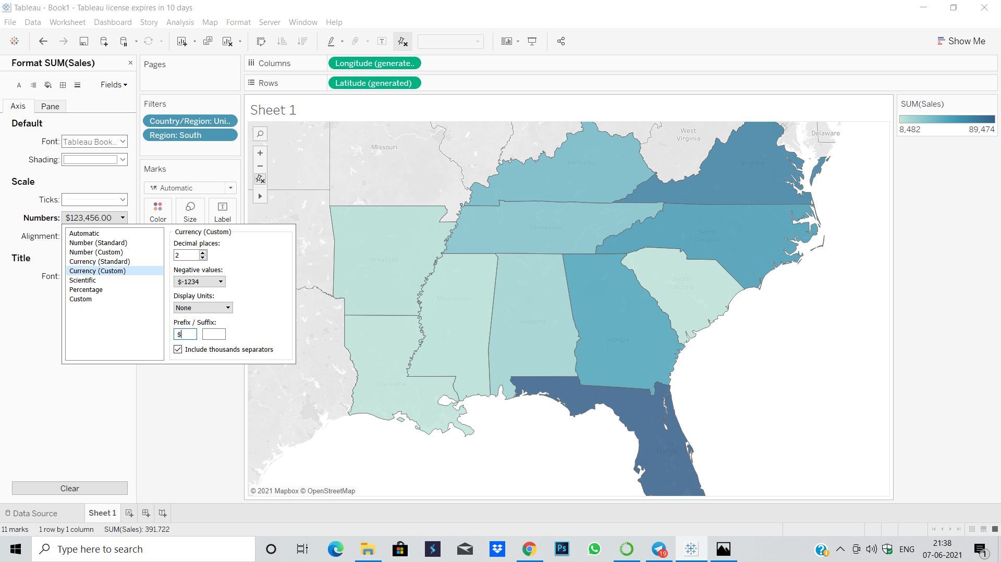
Represent your sales in USD

Slide 6
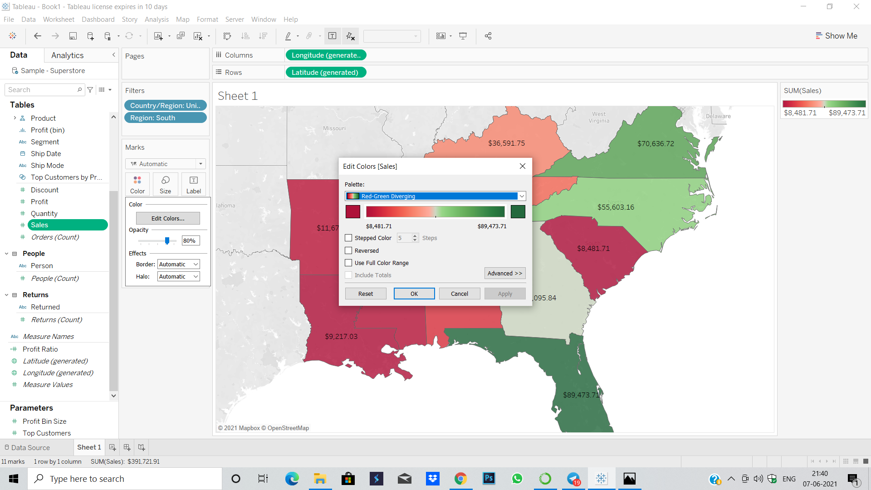
Edit colour for your map

Slide 7
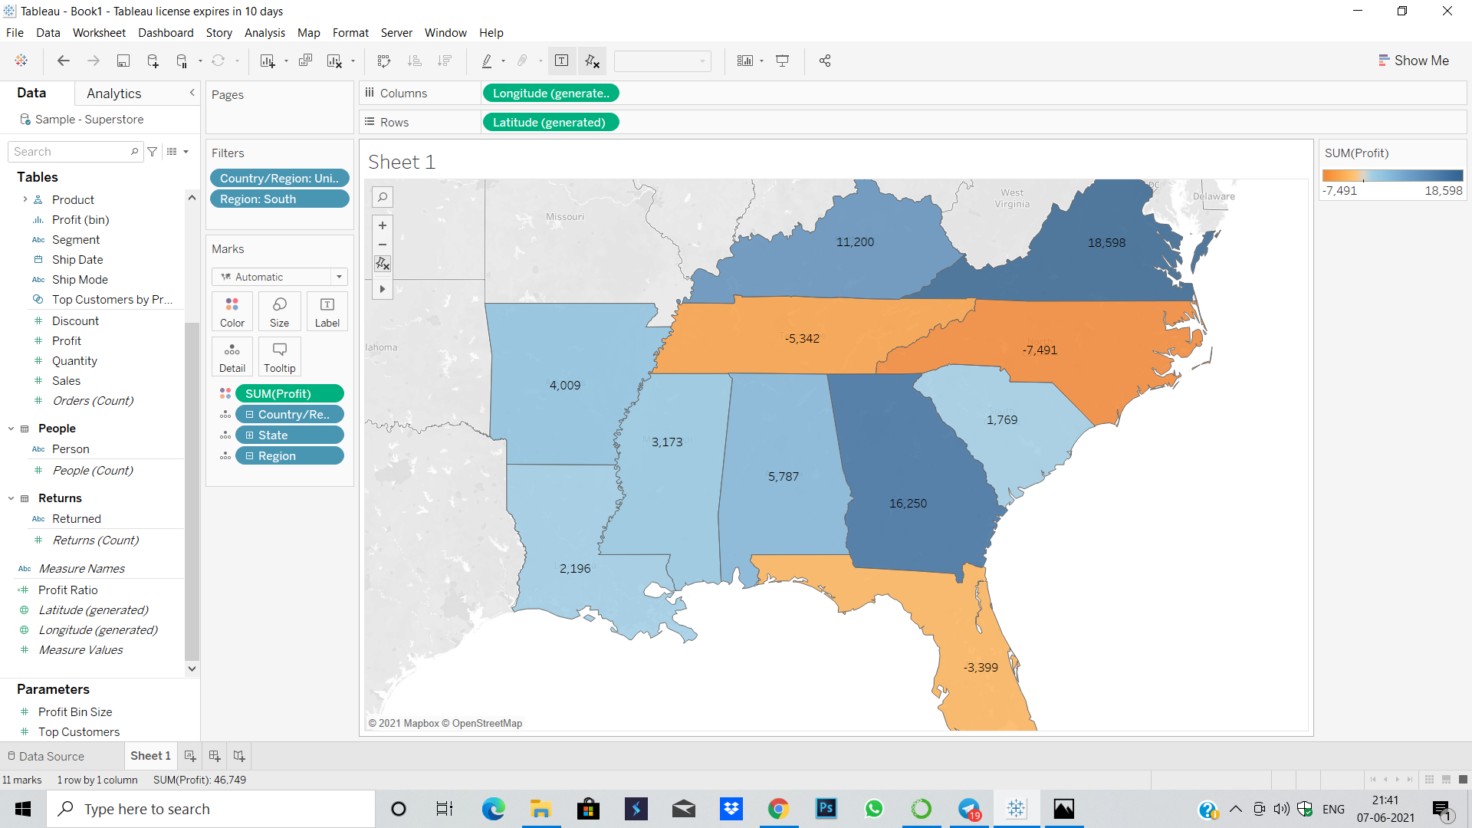
Show profits for all the states in your map

Slide 8
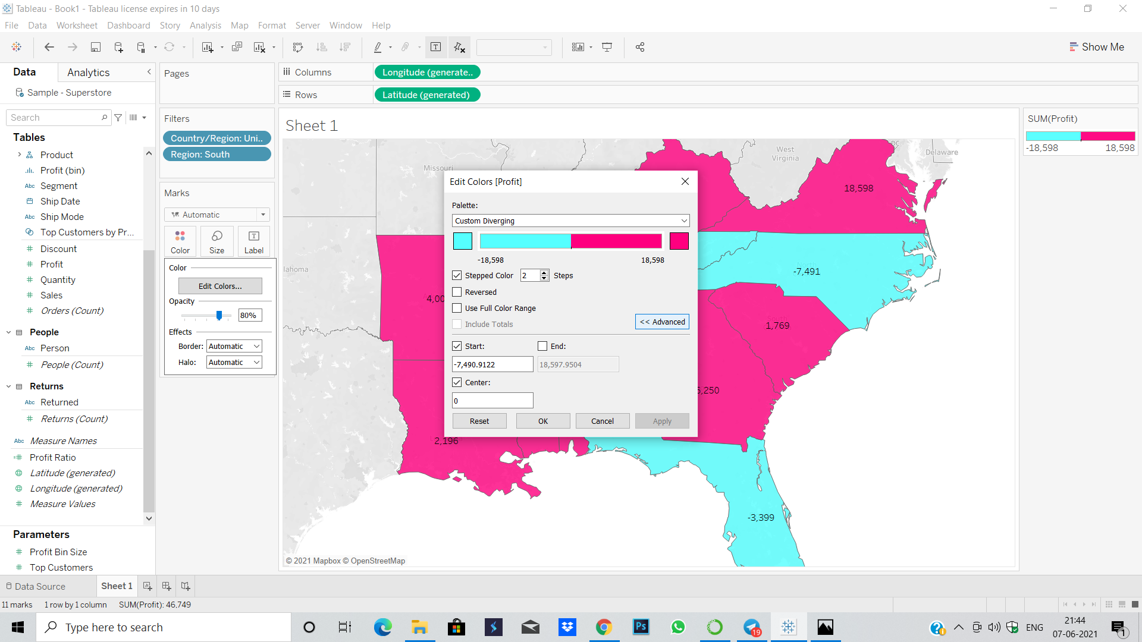
Find out the name of some states having negative profit

Slide 9
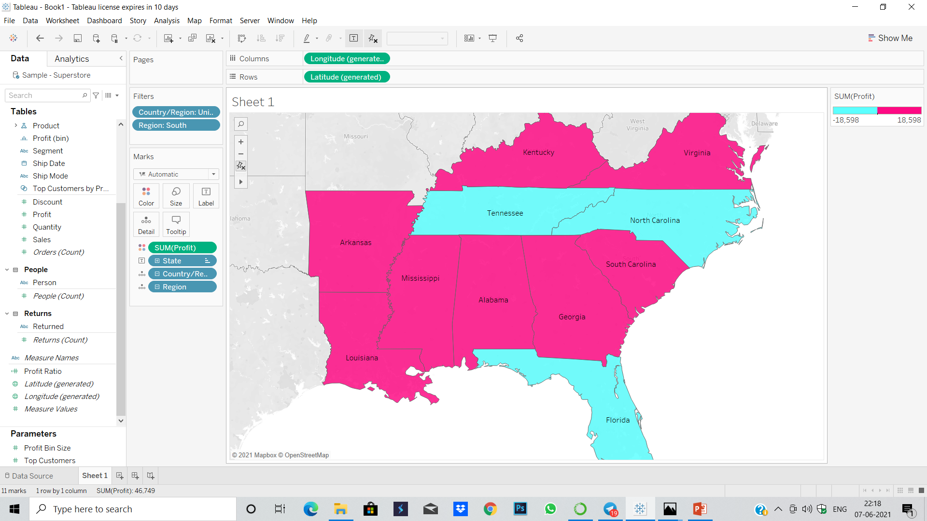
Find out the name of some states having negative profit

